Slide 1
Overview
Customer Care Services
Products Available
New Deals
Business logo
Welcome to Our Site
search
Create Acc
login
About US

Slide 2
Site Features
Accessibility
Navigation
Visual Design
Functionality
Company site features

Slide 3
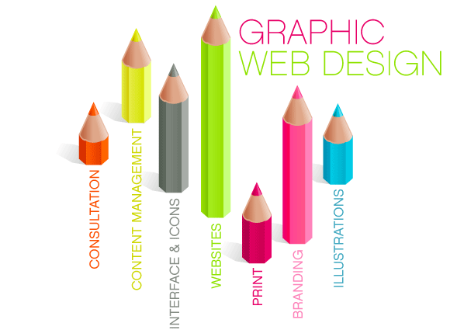
Graphics
Different color different style
3D pictures
Digital Illustrations
Interactive motion graphics

Slide 4
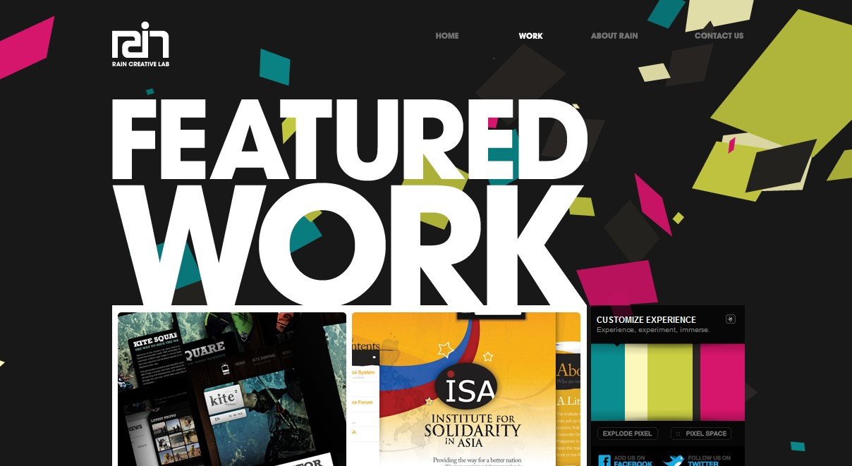
Typography
Typography is just appearance and style of a printed matter
The next step in marketing
Best E-COMMERCE BUSINESS AROUND

Slide 5
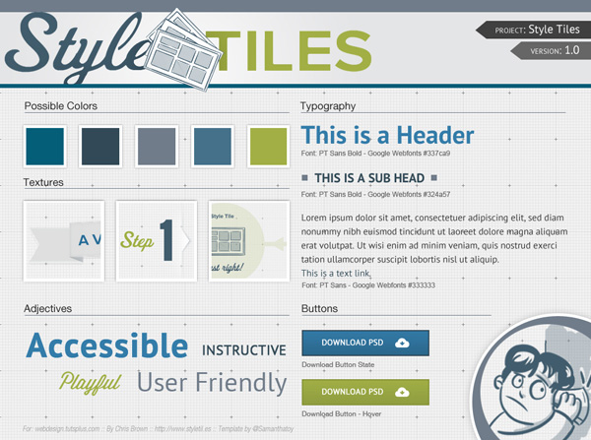
Styles
Different font-styles to make the website more readable
Product Description & Company Policy
Download
User Friendly
Request Order

Slide 6


Company Logo Portfolio
The following is the company’s brand logos
Logos help in product marketing and site branding
eSHOPPED
Bizz

